Slide 1
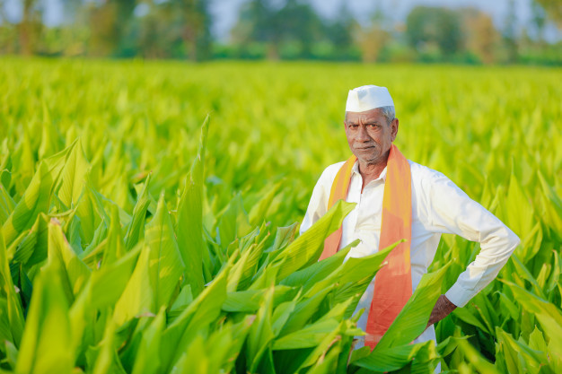
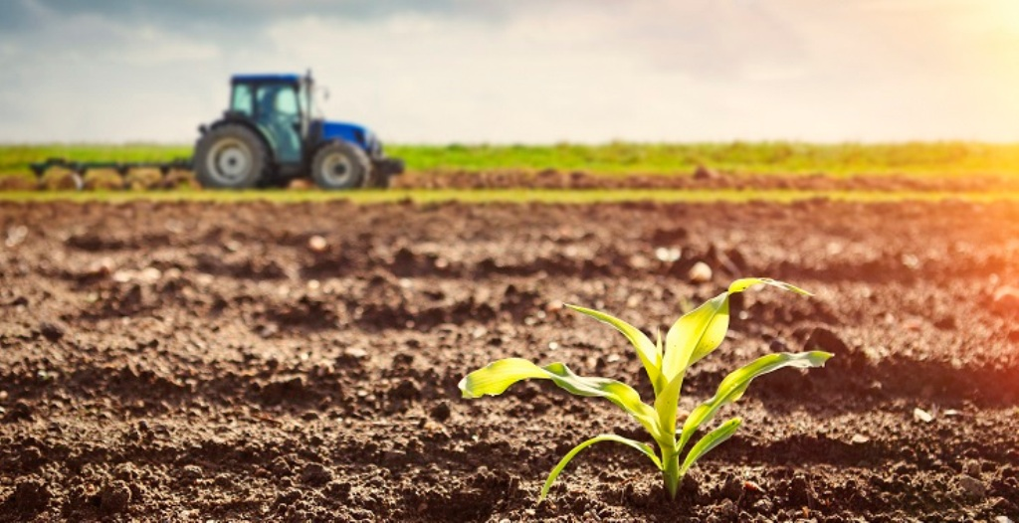
Big Data Case Study: Fasal - A Paradigm Shift
PRANAV DANGE

Slide 2
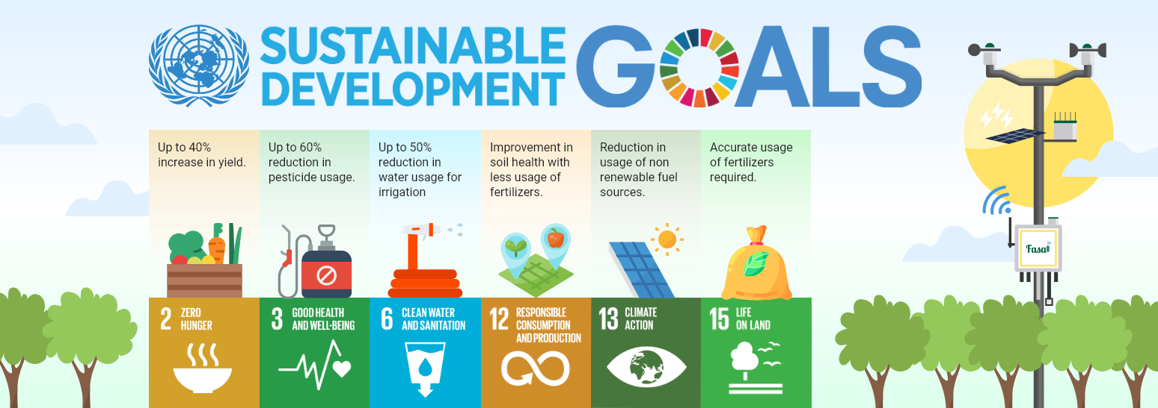
Contents
Fasal – What it is
Problem Statement
How it works and its features
Use of Data and AI
Success Stories
Challenges and Social Impact
Future Plans and Summary

Slide 3
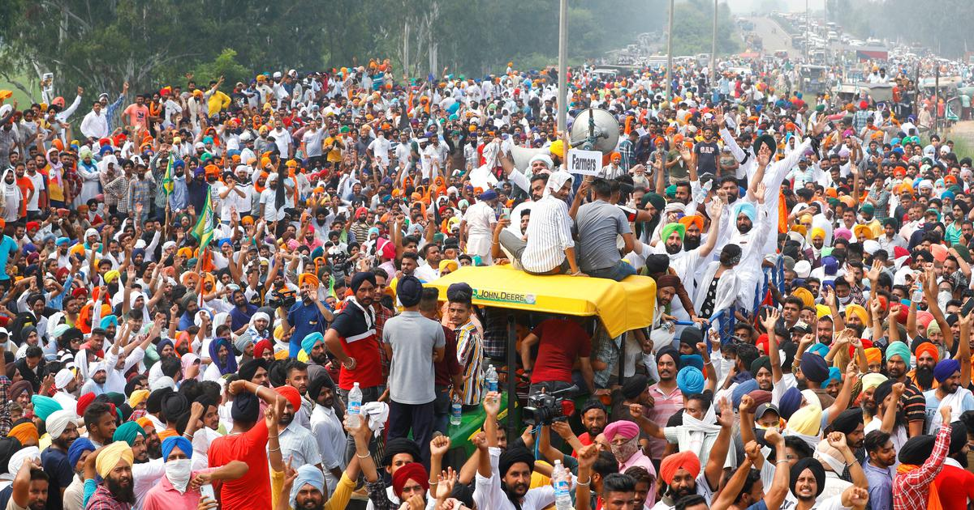
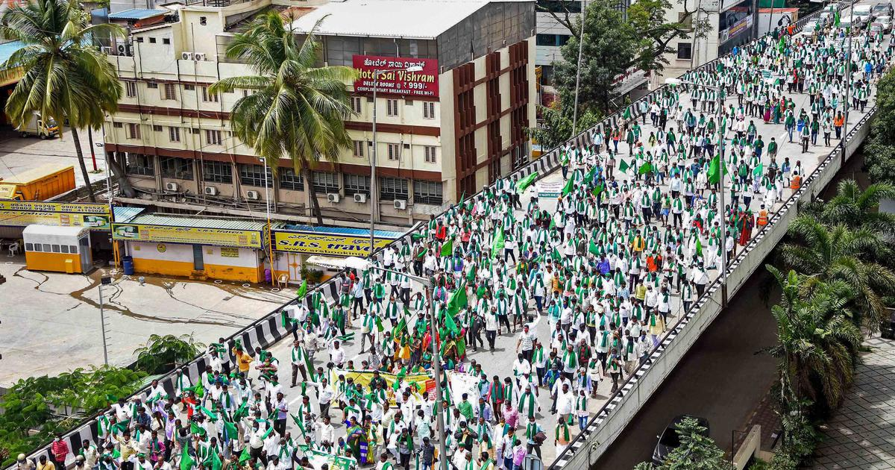
A gloomy Picture

Slide 4
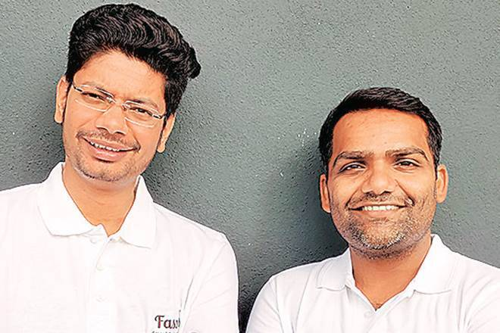
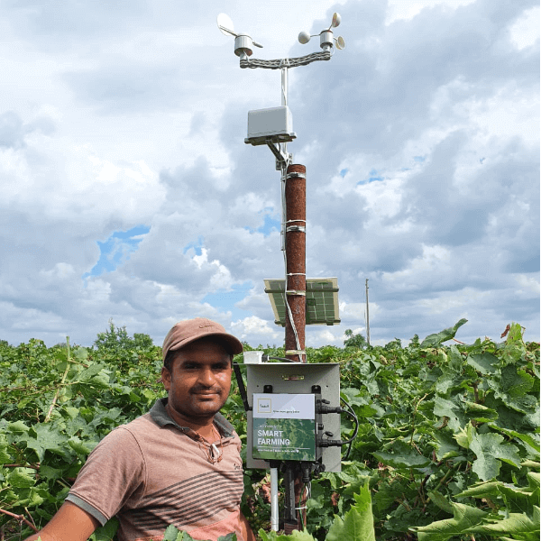
Fasal co-founders Shailendra Tiwari (L) and Ananda Verma

Slide 5

A Series of Questions gave rise to an Idea
How to really deal with all lot of uncertainties in farming and what needs to be done for the same.
"How much irrigation is required for a particular soil type?
When should the crop be irrigated? Is there a chance that a particular disease will attack my crop in the next few days?
How much and which spray to use?
Is this the right weather condition to take a spray?
What are the different activities to be carried out during the different stages of the crop? What type of fertilizers should be used; how much and when?“
Untimely Rain – the most dangerous element
Fasal realized that only data driven farming would take the guesswork out of farming by pinpointing exactly what works and also what doesn't work.

Slide 6
Problem Statement
Inappropriate Weather Forecasts and hence uncertainties
Atmospheric conditions of farm differ vastly from those in the larger areas.
Microclimate of the farm varies in every
The erratic rainfall
Huge water wastage and not real understanding of exactly how much water is needed.
Globally 70% of the total freshwater is used for agriculture. And in fact India leads the world in annual agriculture water withdrawals a total of 761 billion metre cube of water (latest data available in FAO, 2016a), out of which the agriculture water withdrawal was a staggering 688 billion metre cube.
The decision making on when to irrigate is a major issue as well ie. Insticts vs. Insights
No real mechanism for preventing Disease and Pest attacks
Anomalies in the Data Set from the sensors, customers and how to really use it for further analysis

Slide 7
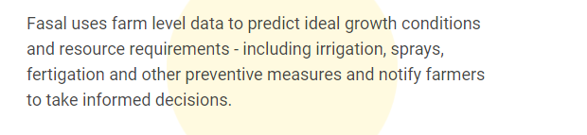
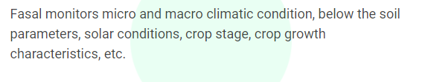
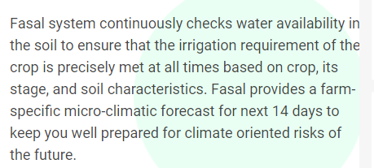
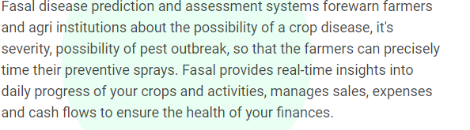
How Fasal Works and what it offers

Slide 8
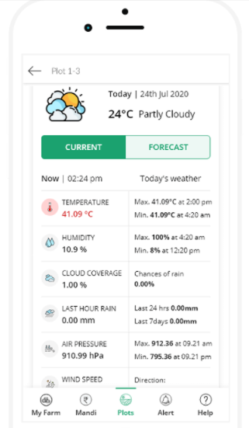
Micro climatic forecast
Fasal provides farm-specific micro-climatic forecasts for the next 14 days to keep you well prepared for weather risks of the future. You can use this forecast to prepare for the future activities at your farm.
A typical Fasal advisory looks like: "High chances of rainfall between 7:00 PM and 9:00 PM on Block 1. Expected amount of rainfall is 3 mm."

Slide 9
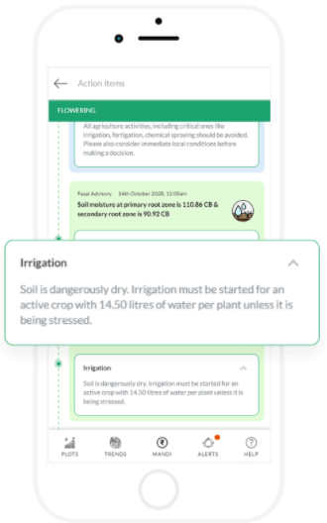
Precise Irrigation
Fasal provides plot level, crop-specific and crop stage specific irrigation requirements precise to the litre per plant. Our system considers aspects such as soil texture, crop, crop-stage, soil water tension, rate of water loss, plant ecology, transpiration etc. to recommend precisely when and how much to irrigate.
A typical Fasal irrigation advisory looks like this: “You need to irrigate Block 1 with 4.3 litres/plant by 4 pm tomorrow.

Slide 10
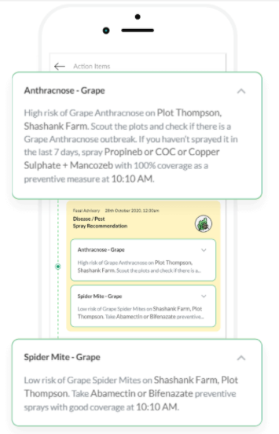
Disease & pest warning
Fasal provides preventive advisories for disease and pest management, informs the farmers which spray they should use and the best time to spray. Fasal tracks the life cycle of various pathogens as well as pests, specific to the crop and crop stage, by monitoring the congenial on-farm micro and macro-climatic conditions and then informs when to take preventive sprays.
A typical Fasal advisory looks like: "High Risk of Downy Mildew on Block 1. Take Revus Top, Mancozeb or Acrobat preventive spray with good coverage at 8 AM."

Slide 11
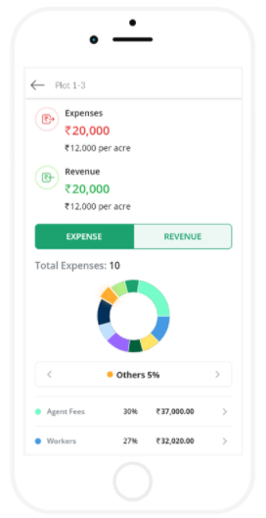
Farm finance management
Fasal lets you plan, monitor and analyze all activities on your farm in a very simple and intuitive way.
It provides real-time insight into daily progress of your crops and activities, manages sales, expenses and cash flows to ensure the health of your farm’s finances.

Slide 12
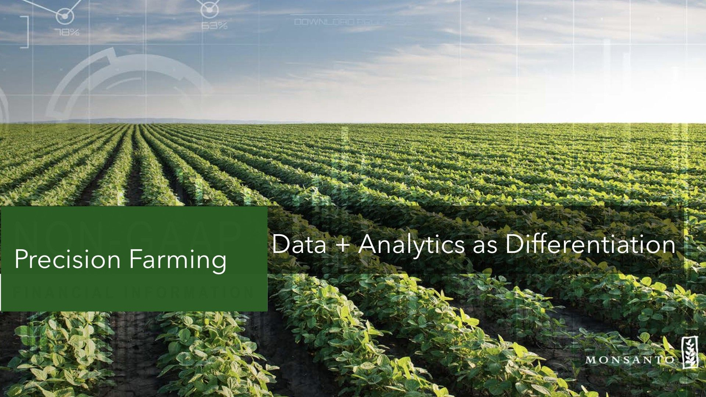
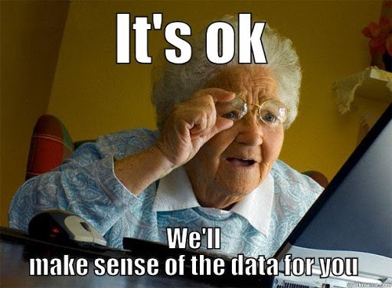
Making sense of data
Fasal collects and store a lot of data
Data comes from IoT devices, customer interactions on the app, and via various external integrations.

Slide 13
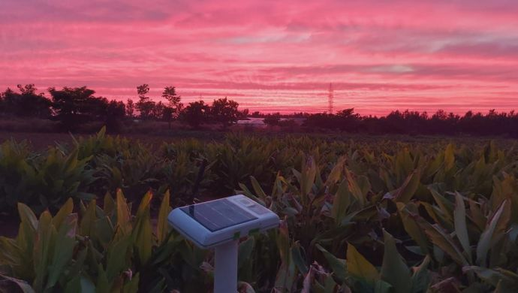
Woo-hoo! This is Version 4.0
In late November 2020, the startup unveiled their fourth version of on-farm sensors called ‘Fasal Kranti’. The self-deployable and plug-and-play device takes less than 5 minutes to deploy at a farm. More importantly, it is equipped with over 12+ sensors to monitor macro-climatic factors such as rainfall, wind speed, wind direction, LUX, solar intensity, micro-climatic factors such as temperature, humidity, leaf wetness, etc, and below the soil parameters like soil temperature, soil water tension at multiple levels.

Slide 14
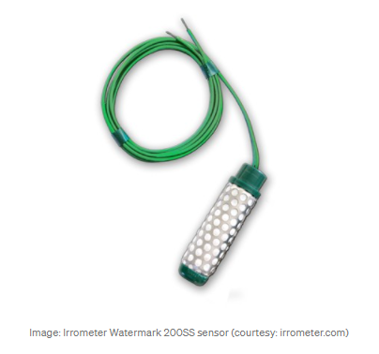
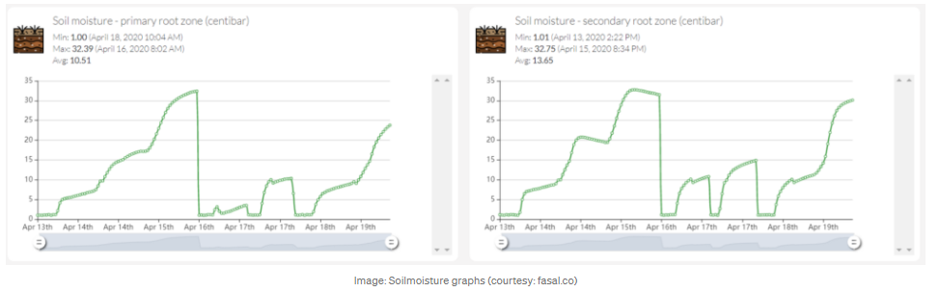
How’s it really done ?
Using these sensors, Fasal algorithms are able to see how much water is available exactly for the plants to absorb.
Step 1:
A sensor node that connects with an array of sensors records data every configured interval, creates a data frame, and pushes it to Fasal backend server on a 4G/3G/GPRS network. The node is solar-powered, supports deep sleep mode, and can be programmed over the air (OTA).

Slide 15
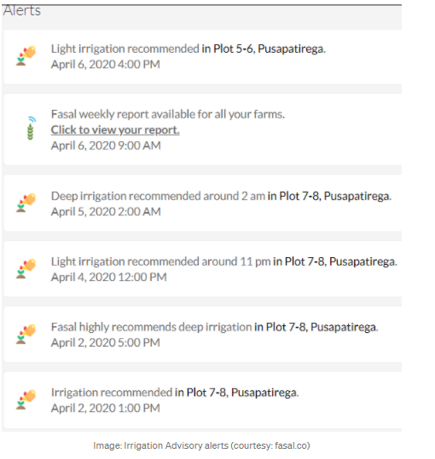
Step 2:
A linearly scalable container-based IoT backend server, always available. Processes the data frame and stores it to Fasal highly available and replicated storage servers.
Step 3:
An app backend and frontend. A single codebase for web-app and all mobile apps. The app backend talks to Fasal storage server to pull data and runs algorithms. The app frontend presents data to users on Web, iOS, and Android.
Step 4:
AI engine which periodically loads data from n different sources, trains the ML algorithms, deploys the model, and gives an endpoint for prediction.
You can view this data live on your mobile app and AI systems give you Irrigation advisories (Light Irrigation, Normal Irrigation or Deep Irrigation) based on a combination of live moisture levels along with many other parameters like Evapotranspiration, VPD, RDIand Micro-climatic conditions.

Slide 16
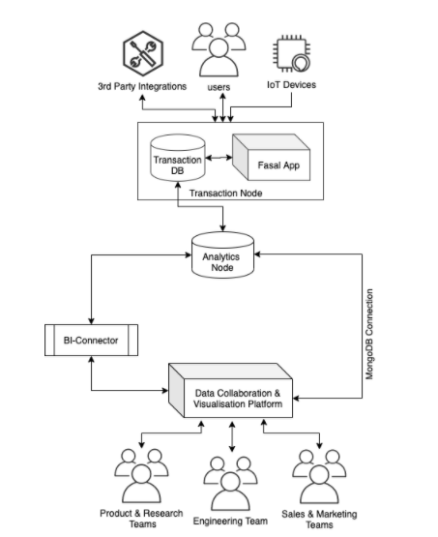
Ad-hoc analysis and Reporting
Analytics Node
BI-Connector
Data Collaboration & Visualization
Redash Deployment on AWS
Supports multiple data sources
SQL query editor
Create amazing dashboards
Get alerts
Data pipeline

Slide 17
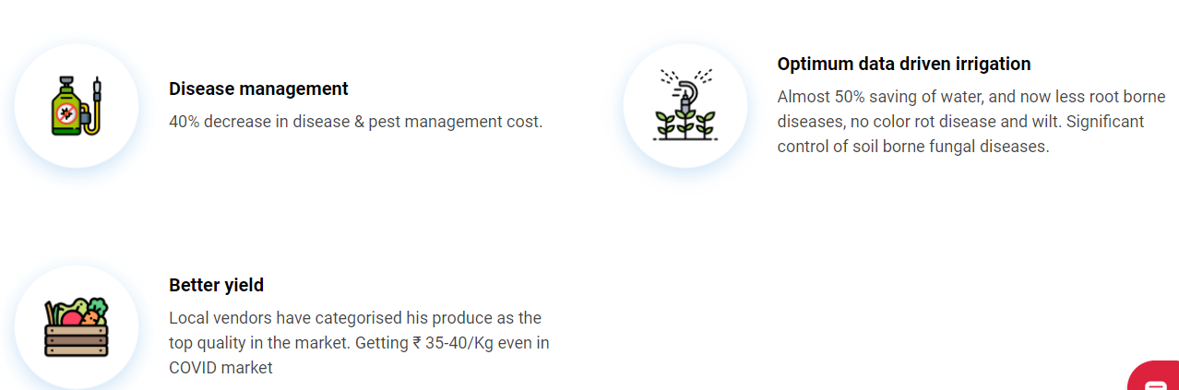
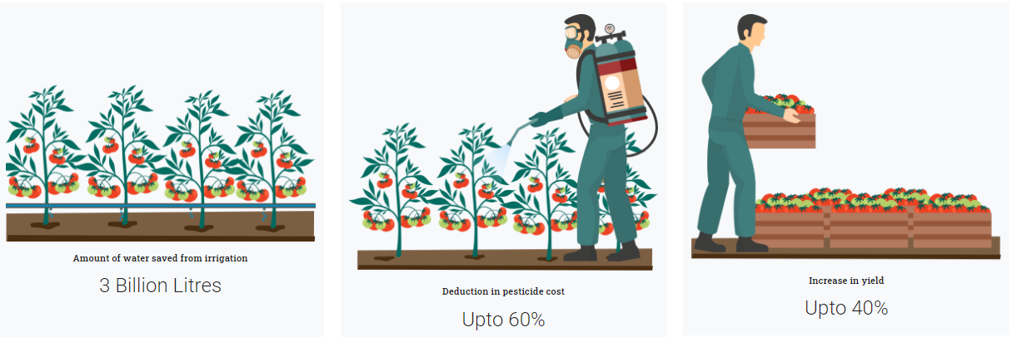
Success Stories

Slide 18
Success Stories
ROI on grapes
Direct monetary benefit of ₹ 78,000
Direct saving by cutting 14 sprays of Downy & Powdery Mildew worth ₹ 47,600
Increase in yield of about half a metric ton
About 8.5 lakh litres of water saved in one season from irrigation
ROI on Chilli
40% decrease in disease & pest management cost
Almost 50% saving of water
Received ₹ 35-40/Kg even in COVID market
ROI on Tomato
Remote management of farm during Covid-19 lockdown.
Saved ₹ 90,000 approximately in disease management
25 tones more yield as compared to previous season
60% less irrigation as compared to previous seasons

Slide 19
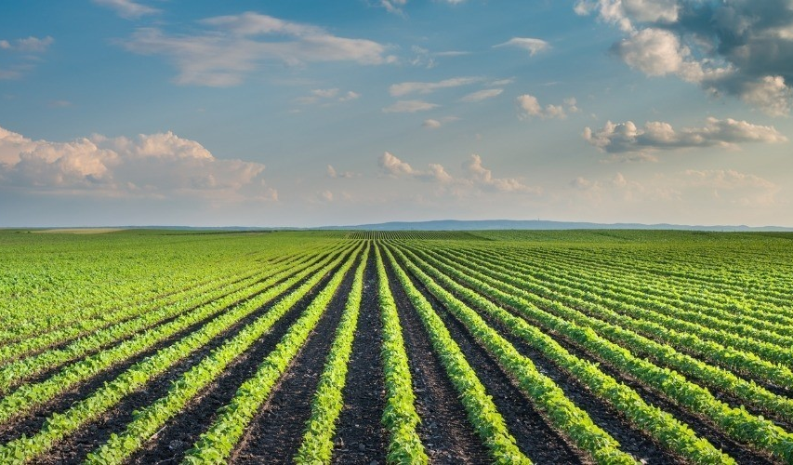
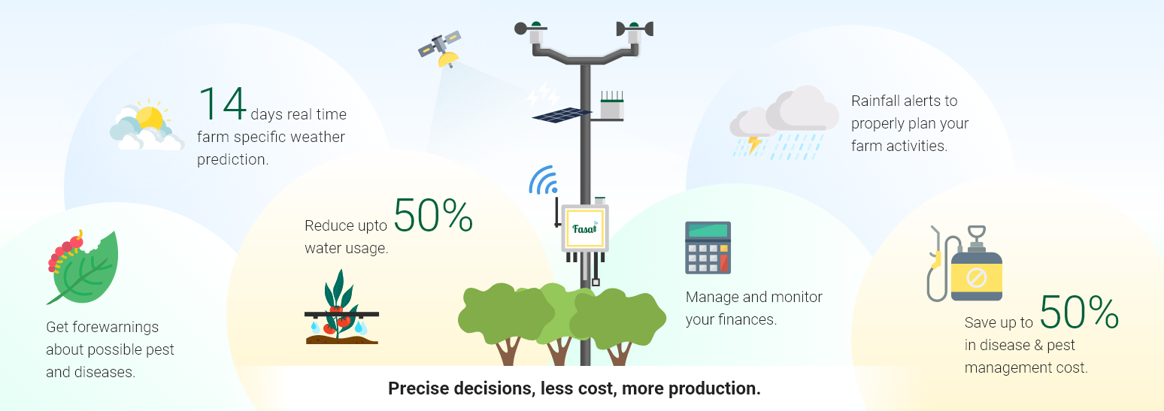
Summary

Slide 20
What is the Future?
At this point of time when things are changing and digital advancements are being made at a fast pace in the country, Fasal looks like a promising and innovative startup that could change the current landscape even faster.
Fasal got acceleration support form Zeroth.ai, which is Asia’s first AI and ML accelerator. It also raised $120K from them with focus on enhancing their AI capabilities. Also, bagged multiple funding from Omnivore.
Fasal is also collaborating with the UC-Berkley Andhra Pradesh Smart village initiative, which is a collaborative initiative between Govt. of Andhra Pradesh and the University of California Berkeley.
The Vison of the Fasal in their words is- “We believe that in the next 5 to 10 years when we have deployed millions of these devices across the farms, the farms and villages may look very different. Our food will be a lot safer. We would be consuming probably half of the water that India is consuming for agriculture. Our farmers would be making a lot more money than they are doing right now,”

Slide 21
Thank You
“So however difficult it may seem, if you have truly found your calling, just go with it and then let time unfold and let time decide but give it your best” - Shailendra Tiwari

